Slide 1
WIRELESS APPLICATION CONTROL USING HAND GESTURES
Presented By:
N.MANMADA SURYA GANESH GUPTHA(210303125064)
T.HARISH REDDY (210303125087)
N.VAMSI KRISHNA (210303125067)
T.SUNDAR SENA REDDY (210303125085)
Guided By:
VISHAL CHOUHAN SIR
Designation
CSE Department
PIET, Parul University
Internal Project Presentation August, 2024

Slide 2
Content
Introduction
Problem Statement
Research Paper Summary (in Tabular form)
Flowchart of the system
Implementation Details
Demonstration of the Project
Testing
Test cases
Conclusion
Future Work
References

Slide 3
Introduction
Gesture recognition uses cameras, sensors, and algorithms to recognize and understand human gestures and convert them into commands for controlling digital devices. Smartphones, gaming consoles, virtual reality systems, and smart home appliances are just a few of the areas where this technology has found integration.
Hand gestures provide a simple and straightforward way to communicate with wireless apps and devices when used for wireless application control. With the help of pre-set gesture-to-control mappings, users may carry out operations like managing media players and minimizing and shutting programs without actually touching the device. With the help of this program, you may remotely operate computer.
The identification, interpretation, and use of gestures across a variety of applications depend heavily on the underlying technologies of computer vision, deep learning, and machine learning.For hand gesture recognition the number of fingers present in the hand gesture is calculated by CNN,using fault spots in the gesture. The acquired gesture is passed via a 3-Dimensional Convolutional Neural Network. CNN isused in succession to recognize the gesture.Gesture recognition is not limited to just human hand gestures, butrather can be used to recognize everything from head nods to different walking gaits.

Slide 4
Problem Statement
In our increasingly interconnected world the demand for user friendly and efficient methods ofinteracting with
digital devices and applications has never been higher the reliance on traditional input devices like keyboards and
touchscreens can be limiting especially in scenarios where users need to control applications from a distance or
when their hands are occupied this project undertaken to solve this challenge by creating a system that allows
users to control applications wireless using hand gestures the primary issue this project aims to address is the
need for a more accessible and natural way to interact with technology this involves overcoming the constraints of
current input methods developing intuitive and responsive gesture recognition technology and ensuring that the
solution is flexible and adaptable to various applications and user preferences by focusing on these fundamental
challenges this project aims to improve the overall user experience making technology more accessible and
natural for a wide range of users in different contexts from smart home control to virtual reality gaming.

Slide 5
Summary
Sr. number | Paper Title | Publisher | Year | Take-away points
1 | A Deep Convolutional Neural Network Approach for Static Hand Gesture Recognition. | SCIENCE DIRECT | 2020 | This paper proposes a method for the automatic recognition of hand postures using convolutional neural networkswith deep parallel architectures. The proposed model avoids the need for hand segmentation, which is a very difficult task in images with cluttered backgrounds. Eventhough many different segmentation techniques are possible based on skin color, hand shape etc.
2 | A Real Time Hand Gesture Recognition System Using Motion History Image | SCHOLARLY ARTICLES | 2010 | In this paper, a face based adaptive skin color model and a motion history image based hand moving direction detection method were proposed. There are four dynamic hand gestures hand moving up, moving down, moving left, and moving right and two static hand gestures fist and waving hand defined in this paper.
3 | Controlling Media Player with Hand Gestures using Convolutional Neural Network | INSTITUTE OF ELECTRICAL AND ELECTRONICS | 2021 | • This paper presents the work to control the media player using the hand gesture recognition system.The OpenCV techniques are used to capture the images, 2-Dimensional Convolutional Neural Network is used to extract features and predict the gestures,PyAutoGUI is used to control the keyboard keys whenever a gesture is integrated with it is predicted.

Slide 6
Summary
Sr. number | Paper Title | Publisher | Year | Take-away points
4 | Video Controlling Using HandGestures for Disabled People | SCHOLARLY ARTICLES | 2021 | This research paper addresses an important aspect of assistive technology by presenting a system that enables video control through hand gestures, specifically designed to cater to the needs of disabled individuals.
5 | A Smart Vision Based Single Handed Gesture Recognition system using deep neural networks |  | 2021 | The proposed CNN architecture performs well with minimum filters and layers.
6 | Hand gesture classification using a novel CNN-crow search algorithm | SCIENCE DIRECT | 2021 | This research paper introduces a novel approach to hand gesture classification by combining Convolutional Neural Networks (CNNs) with a specialized optimization technique called the Crow Search Algorithm (CSA).

Slide 7
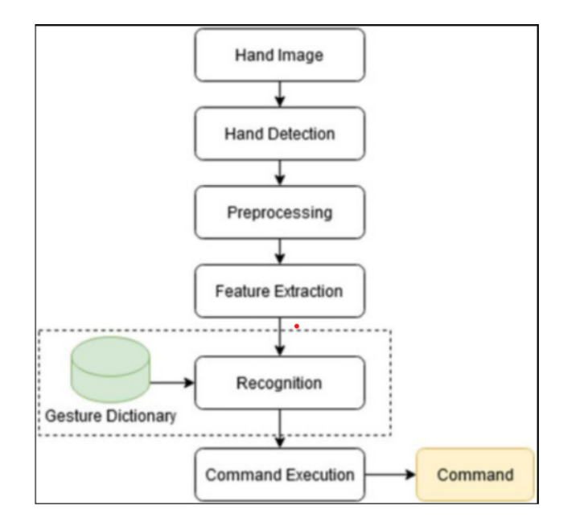
Flowchart of the system

Slide 8
Implementation Details
Software Development
Developing software for wireless applications control using hand gestures involves several stepsand
considerations.Here’s a general guide to get you started:
Define Requirements: Understand the specific requirements of your application. What type of wireless
communication will you use (Bluetooth, Wi-Fi, etc).
Choose a Development Platform: Select a platform or framework suitable for your project. Depending on
your expertise and requirements, options could include: Mobile platforms (iOS, Android) Web-based
frameworks (JavaScript libraries like TensorFlow.js or OpenCV.js) Desktop applications (Python with libraries
like OpenCV) Wireless Communication
Setup: Implement the wireless communication protocol between your gesture control device
(e.g.,smartphone, wearable device) and the controlled device (e.g., computer, IoT device). Ensure that the
communication is reliable and secure.

Slide 9
Implementation Detail
System Integration:
System integration in wireless applications control using hand gestures involves connecting and coordinating
different components of the system to ensure seamless communication and interaction. Here’s a breakdown of
the key aspects of system integration for this type of applications.
Testing:
Testing in wireless applications control using hand gestures is crucial to ensure the reliability, accuracy, and
usability of the system.Test individual components of the system, such as gesture detection algorithms,
communication protocols, and command translation modules.Test the integration of different system
components to ensure they work together as expected.

Slide 10
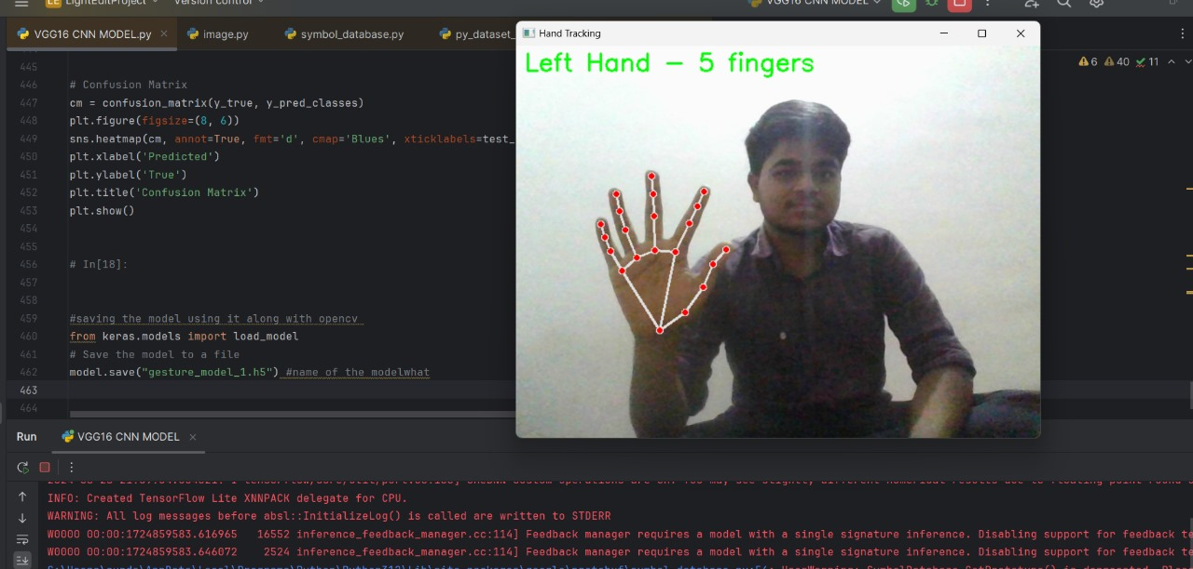
Screen shots of implemented work

Slide 11
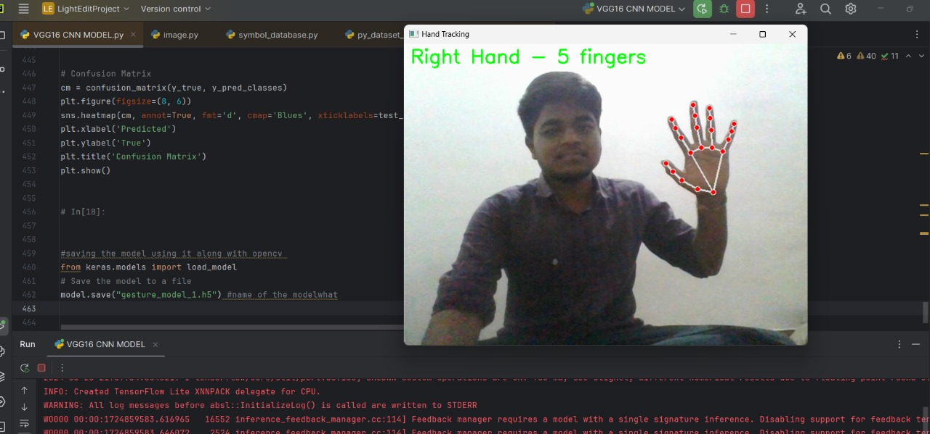
Screen shots of implemented work

Slide 12
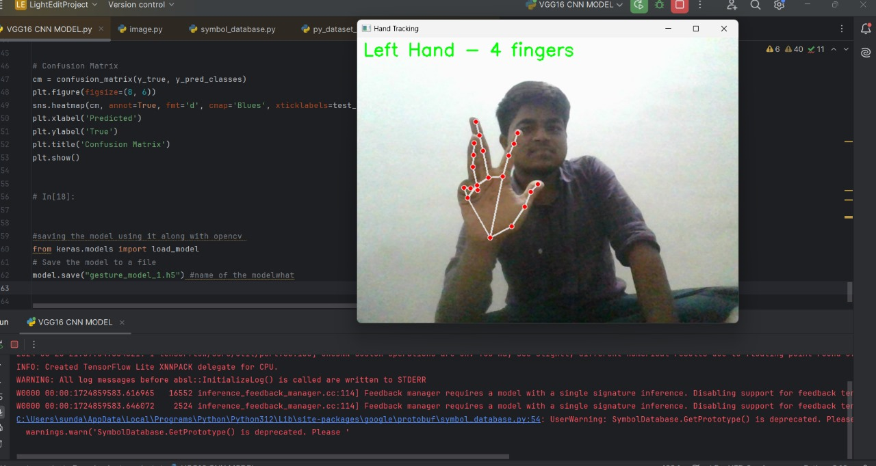
Screen shots of implemented work

Slide 13
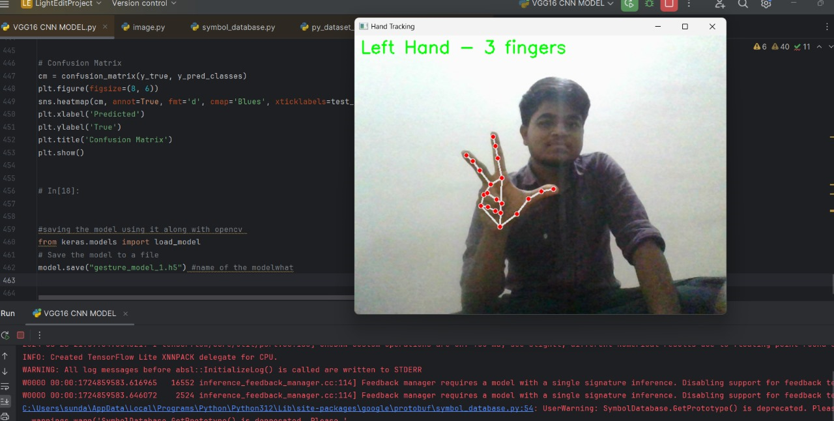
Screen shots of implemented work

Slide 14
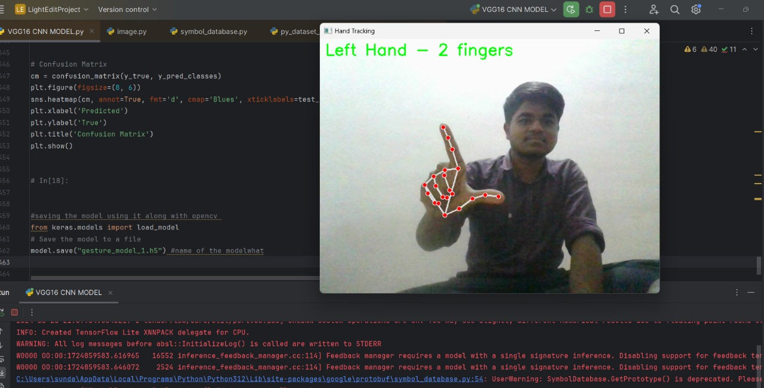
Screen shots of implemented work

Slide 15
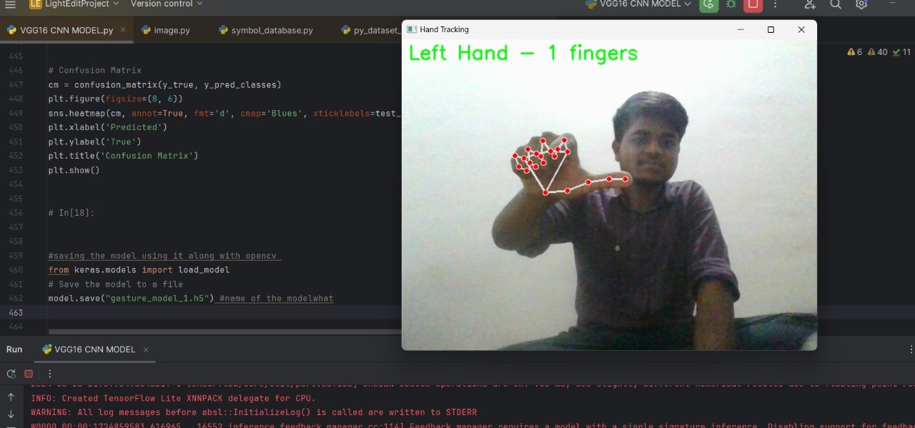
Screen shots of implemented work

Slide 16
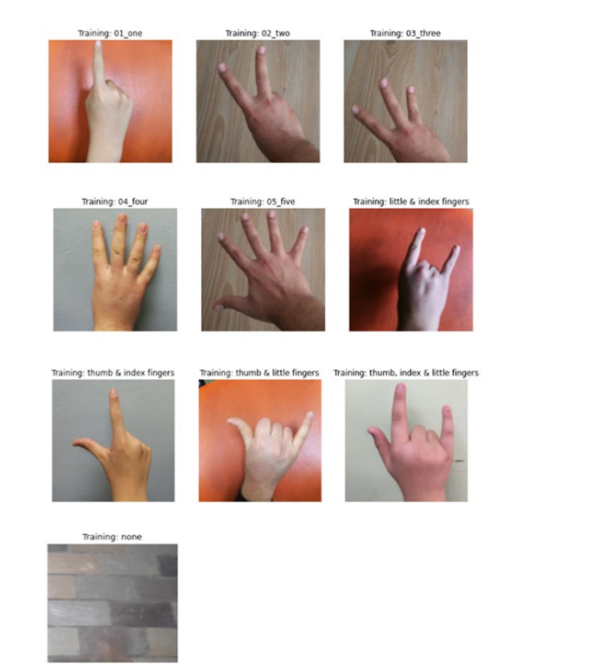
Testing of the Project

Slide 17
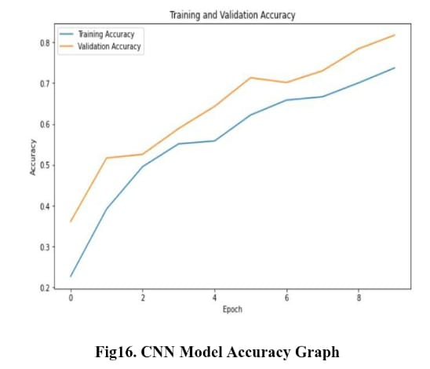
Testing of the Project

Slide 18
Conclusion
This paper presents the work to control the media player controller, PPT slide changing, minimizing,maximizing,
closing and restore the previous minimize window (or) application using the hand gesture recognition system.
The Open-CV techniques are used to capture the images, 2- Dimensional Convolutional Neural Network is used
to extract features and predict the gestures, PyAutoGUI is used to control the keyboard keys whenever a
gesture is integrated with it is predicted. A custom dataset of 10 gestures is collected to test the suggested
model. This model is also tested with these gestures in real-time to examine the accuracy of the recommended
system. The VGG-16 CNN model achieved a high accuracy of 88.94, providing a user-friendly, cost-effective
approach tointeraction with computer systems. The future scope is to work on improving the gesture
recognition capabilities in different environments such as in medical fields,AI.

Slide 19
Future Work
In future we can also add so many applications control of any device using gesture
recognition. Here we have done with the Cnn model and Vgg-16 Cnn model and we
got a good accuracy.So, now we can try to improve the accuracy of gesture
recognition by applying various algorithms in deep learning .
In future we can also improve the ranging distance of the hand symbols detection
from web cam as compared to now.

Slide 20
References
1. V.Aditya, R.Rajesh (2020). A Deep Convolutional Neural Network Approach for Static Hand Gesture Recognition.
Committee of the Third International Conference on Computing andNetwork Communications (CoCoNet’19),
Volume(171), Pages 2353-2361.
2. Hsieh Chiung, Liou, Dunga-huna, Lee David (2010). A Real-Time Hand Gesture Recognition System Using
Motion History Image. 2nd International Conference on Signal Processing Systems (ICSPS), Volume(II), Page
394-398.
3. Nagalapuram, G. D., Roopashree, S., Varshashree, D., Dheeraj, D., Nazareth, D. J. (2021). Controlling Media
Player with Hand Gestures Using Convolutional Neural Network. IEEE Mysore Sub Section International
Conference (MysuruCon), Volume(1), Pages 1-8.
4. Idrees, M., Ahmad, A., Butt, M. A., Danish, H. M. (2021). Controlling PowerPoint Using Hand Gestures in
Python. Webology (ISSN: 1735-188X), Volume(18), Page 1372-1388.
5. Wachs, J. P., Kolsch, M., Stern, H., Edan, Y. (2011). Vision-based hand-gesture applications. ¨Communications of
the ACM, 54(2), 60-71.

Slide 21
6. Sakthimohan, M., Elizabeth Rani, G., Navaneethakrishnan, M., Revathi, S., Naik, B. T., Reddy, P. V. (2023).
Development of an Automated Hand Gesture Software to Control Volume for Computer. International
Conference on Intelligent Systemsfor Communication, IoT and Security (ICISCoIS), Volume(1), Pages 382-386.
7. Al-Hammadi, M., Muhammad, G., Abdul, W., Alsulaiman, M. (2020). Hand Gesture Recognition Using 3D-CNN
Model. IEEE Consumer Electronics Society, Volume(1), Pages 2162-2248.
8. Haria, A., Subramaniana, A., Asokkumara, N., Poddar, S., Nayaka, J. S. (2017). Hand Gesture Recognition for
Human-Computer Interaction. 7th International Conference on Advances in Computing Communications, ICACC,
Volume(115), Pages 367-374.
9. Hakim, N. L, Timothy K.Shih, Kasthuri Arachchi.S. P, Aditya Wisnu, Yi-Cheng, Chih_x0002_Yang.(2019). Dynamic Hand
Gesture Recognition Using 3DCNN and LSTM with FSM ContextAware Model. Volume(1), Pages 1-19.
10. Granit Luzhnica, Elizabeth Lex, Viktoria Pammer. A Sliding Window Approach to Natural Hand Gesture
Recognition using a Custom Data Glove. In: 3D User Interfaces (3DUI); 2016 IEEE Symposium on; 2016 Mar 19 ;
New York : IEEE; 2016 ; p.81-90.

Slide 22
Thank you

